Slide 1
Customer Data Analysis Istanbul Shopping Malls –(2021-2023)
BY
Name : JENIHELAN M
Project id: PTID-CDA-MAR-26-1371
Project Code: PRDA-05
Date : 23/03/2026

Slide 2
INTRODUCTION
Customer data helps understand buying behavior
Analysis based on gender, age, category & payment
Built using Power BI dashboard

Slide 3
OBJECTIVES
Analyze customer shopping behavior by gender and age group
Identify top customer segments and product categories
Examine payment preferences and generate recommendations

Slide 4
Dataset overview
99,000+ transactions
10 shopping malls in Istanbul
Years: 2021–2023
Fields: Invoice Number, Customer ID , Gender, Age, Category, Quantity, Price, Payment Method, Invoice Date, Shopping Mall

Slide 5
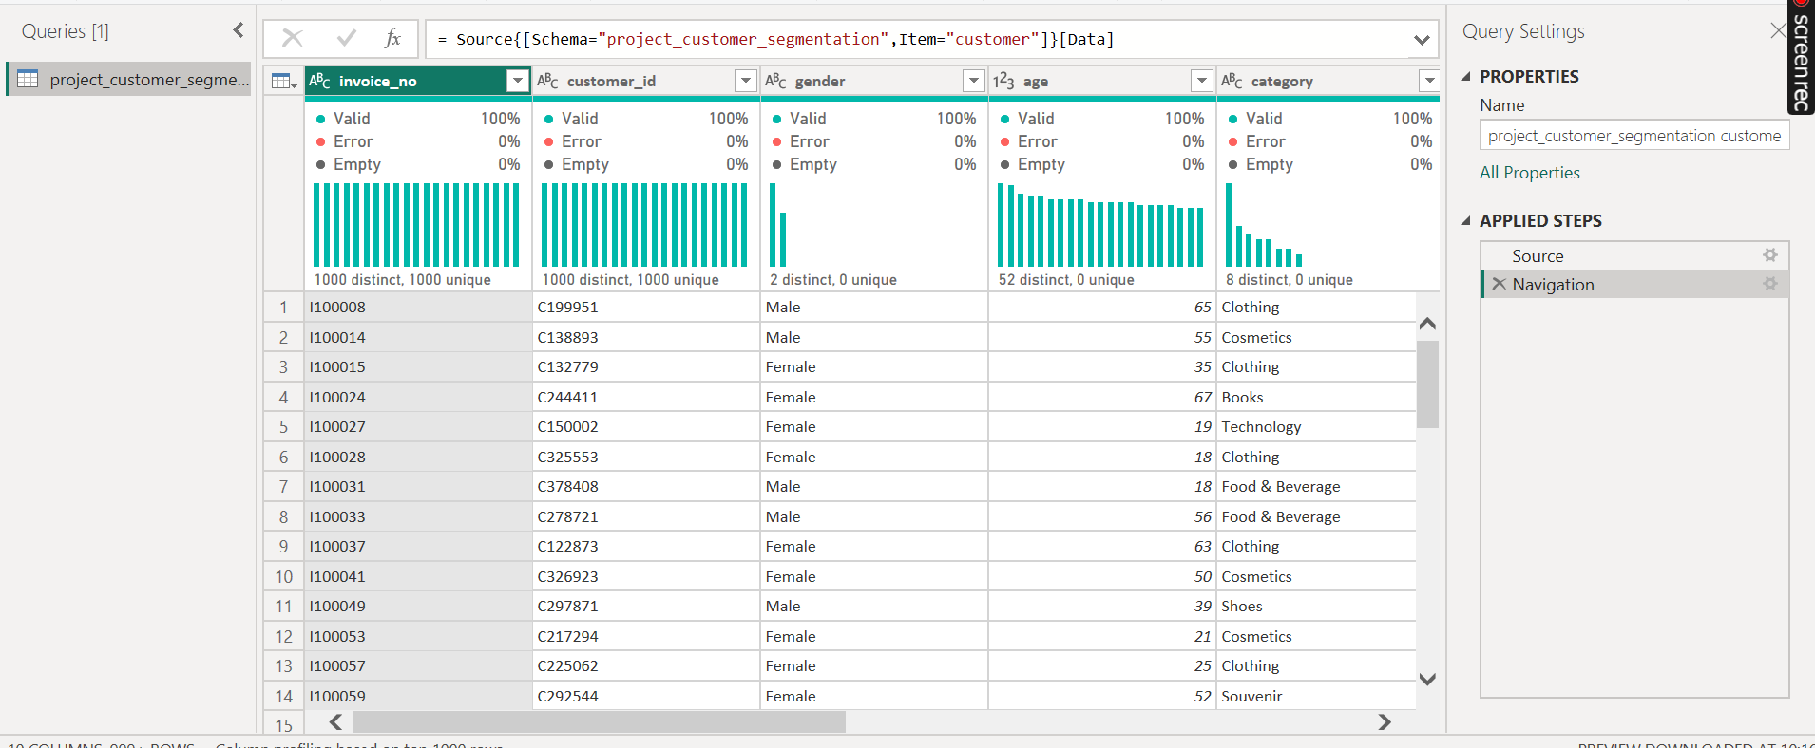
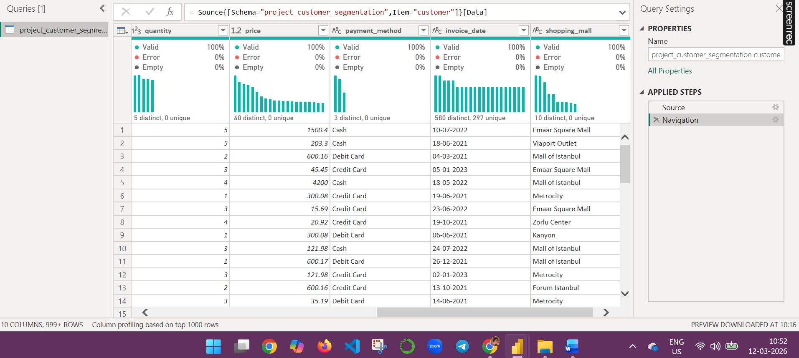
Dataset

Slide 6
Data Preparation
Removed duplicates
Created new measure :
Revenue = Quantity × Price
Created Age Group column
Cleaned data using Power Query

Slide 7
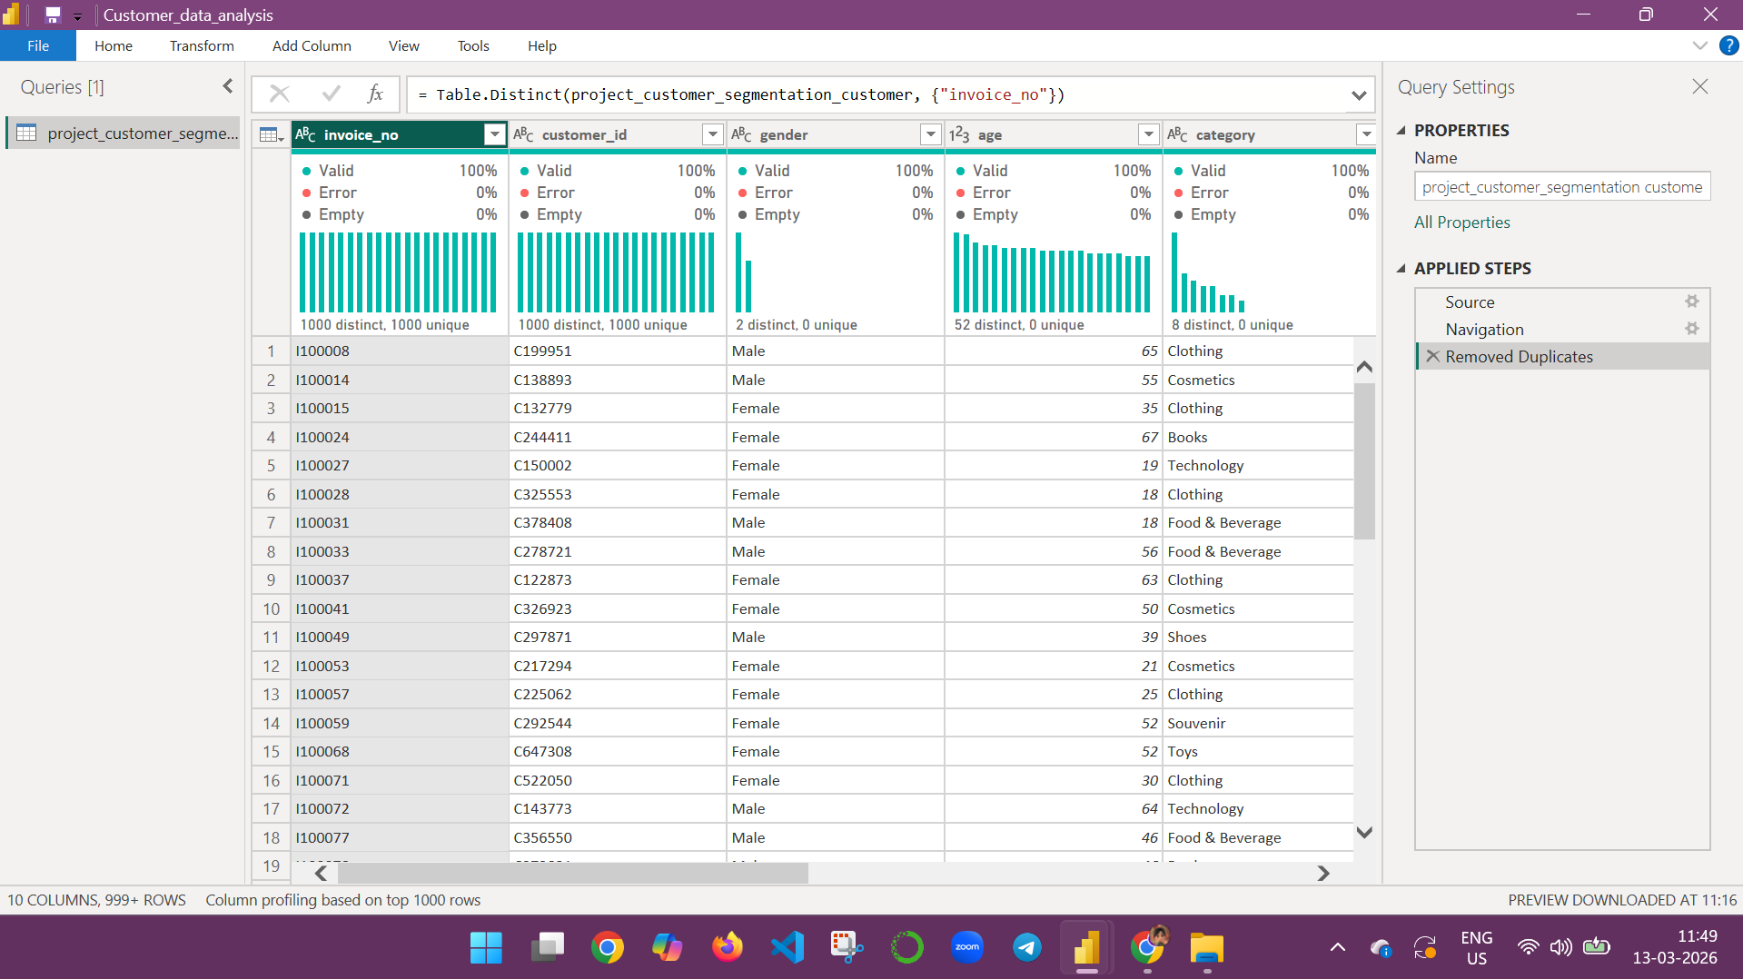
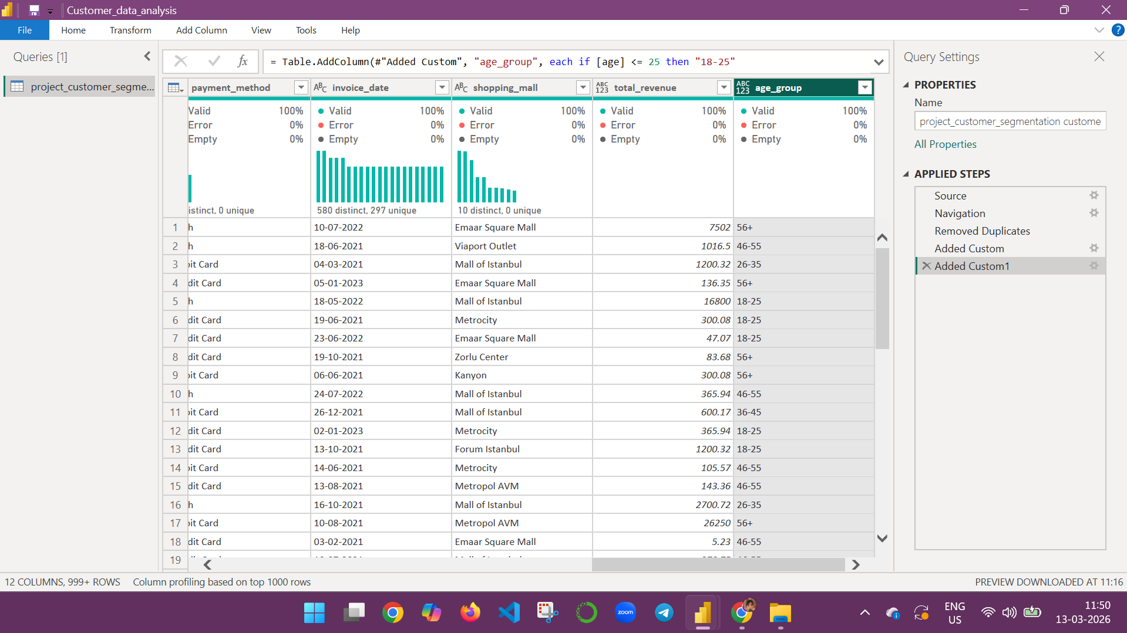
Data Cleaning

Slide 8
Dashboard overview
Gender Analysis
Age Analysis
Category Analysis
Payment Analysis
4 Pages
Total Sales: 251.51M
Transactions: 99K
Products Sold: 299K
KPI Cards

Slide 9
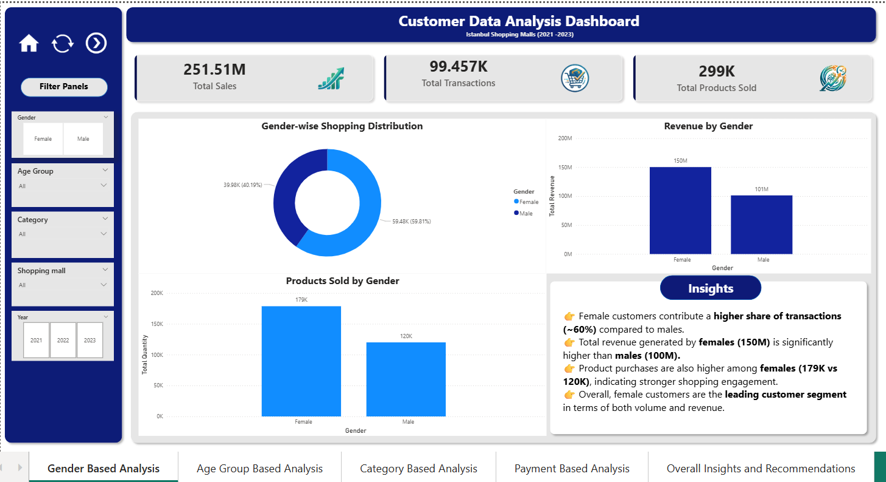
Gender based analysis

Slide 10
Gender Insights
Female: ~60% transactions
Male : ~40% transactions
Products Sold: 179K (Female) vs 120K (Male)
Revenue: 150M (Female) vs 101M (Male)

Slide 11
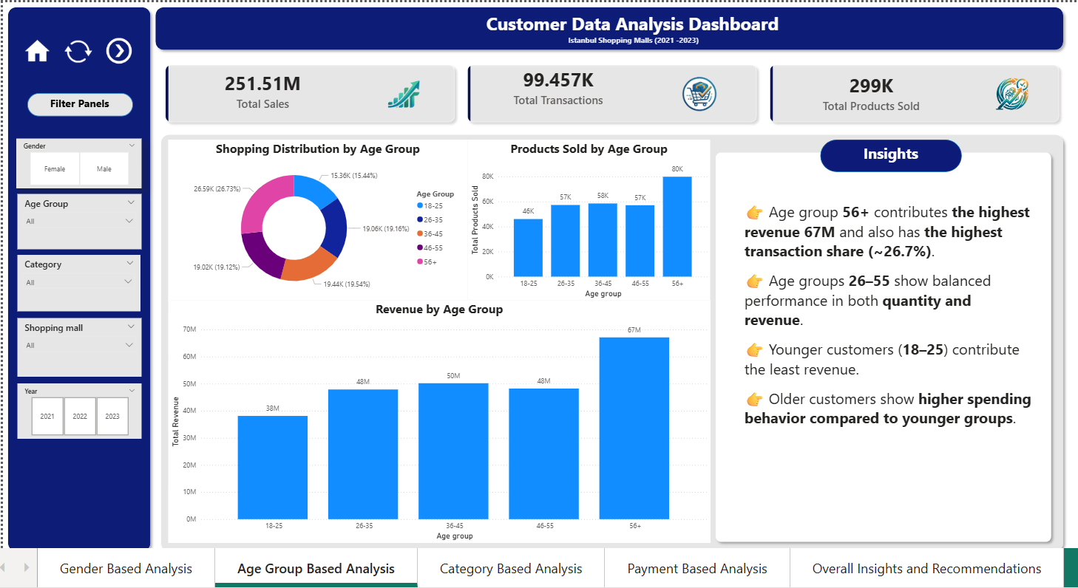
Age based analysis

Slide 12
AGE GROUP Insights
56+ → Highest revenue (67M)
56+ → Highest products (80K)
18–25 → Lowest contribution
26–55 → Balanced performance

Slide 13
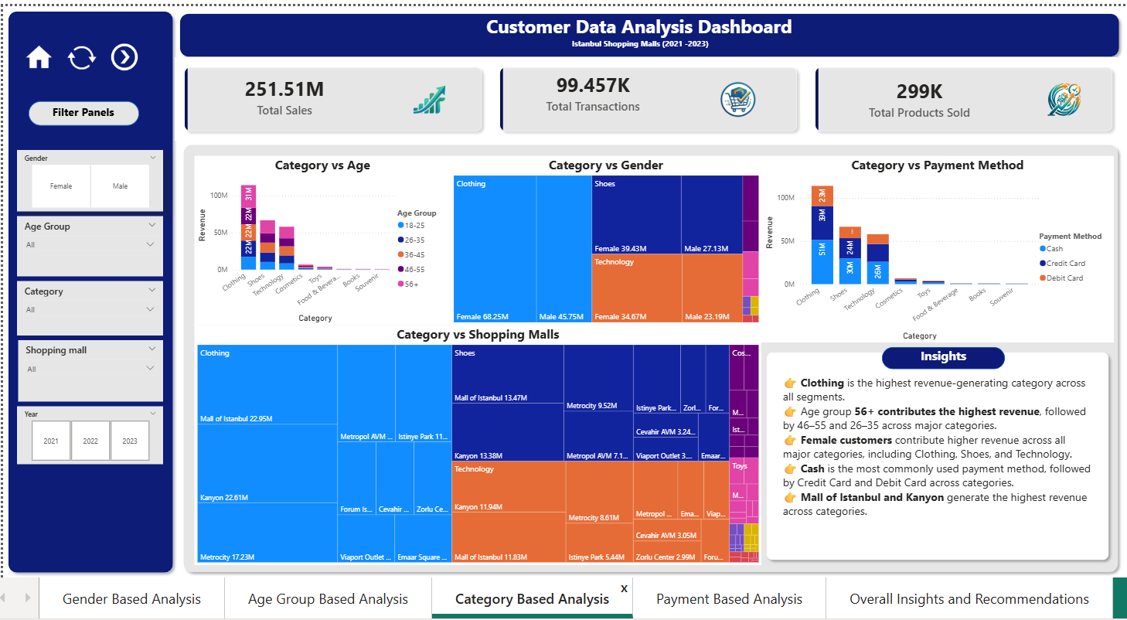
Category based analysis

Slide 14
Category Insights
Top categories:
Clothing (Highest Revenue)
Shoes
Technology
Female contribution higher
Mall of Istanbul & Kanyon → top malls

Slide 15
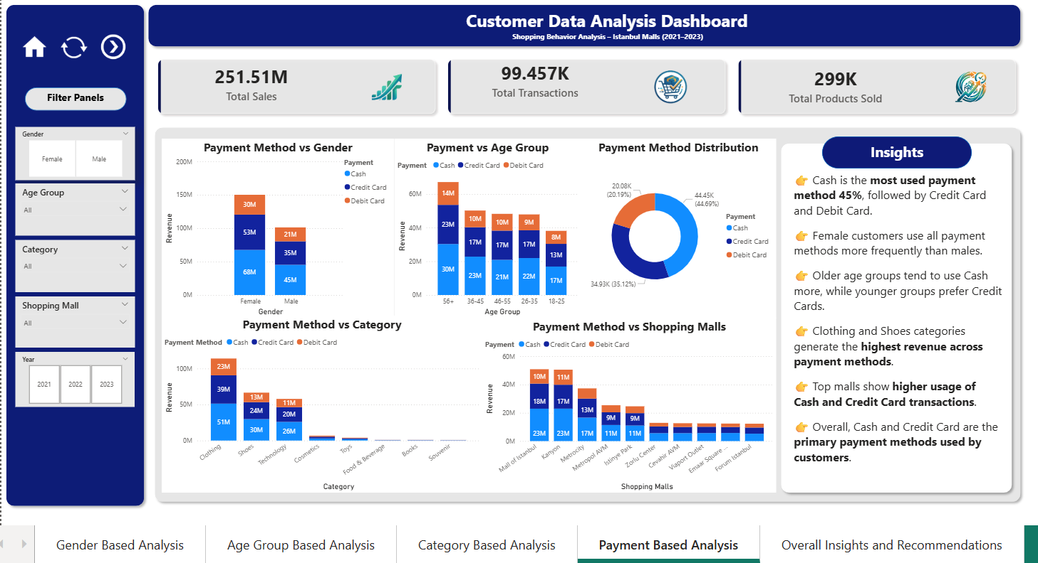
Payment based analysis

Slide 16
Payment Insights
Cash: ~45%
Credit Card: ~35%
Debit Card: ~20%
Cash preferred across all groups

Slide 17
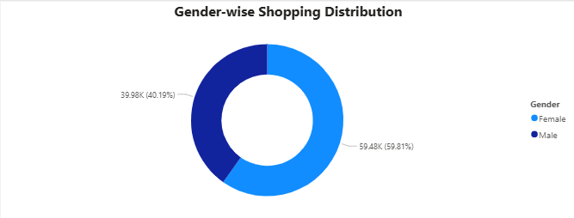
1.How is the shopping distribution according to gender?
Female customers account for ~60% of transactions, indicating higher participation than males

Slide 18
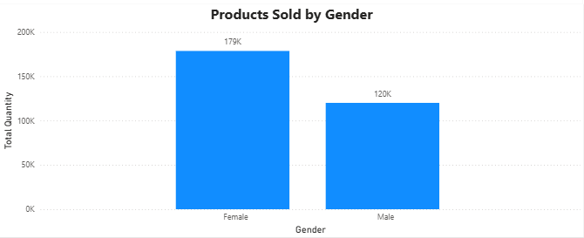
2.Which gender did we sell more products to?
More products were sold to female customers 179K compared to male customers 120K

Slide 19
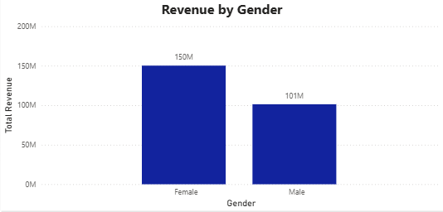

3.Which gender generated more revenue?
Female customers generated higher revenue 150M than male customers 101M

Slide 20
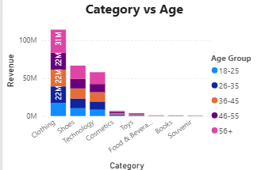
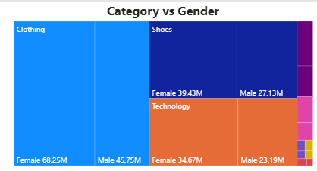
4.Distribution of purchase categories relative to other columns?
Clothing is the top category, with higher contribution from females and the 56+ age group

Slide 21
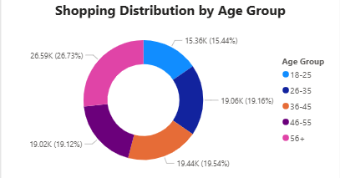
5.How is the shopping distribution according to age?
The 56+ age group has the highest transaction share (~26.7%), while 18–25 contributes the least

Slide 22
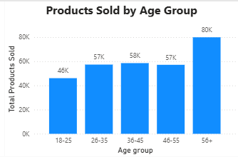
6.Which age category did we sell more products to?
The 56+ age group purchased the most products 80K, indicating higher buying volume

Slide 23
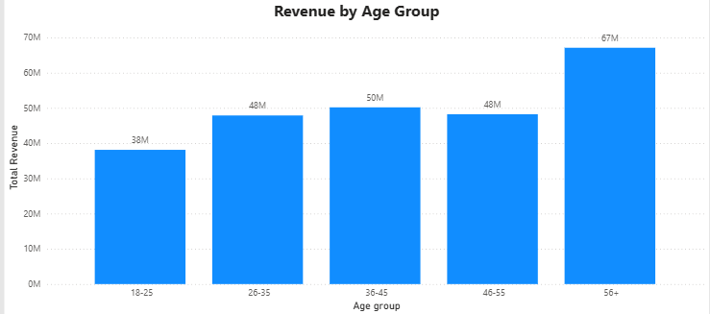
7.Which age category generated more revenue?
The 56+ age group generated the highest revenue 67M, showing strong purchasing power

Slide 24
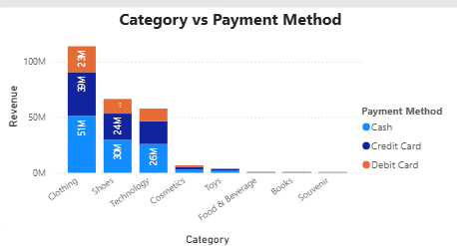
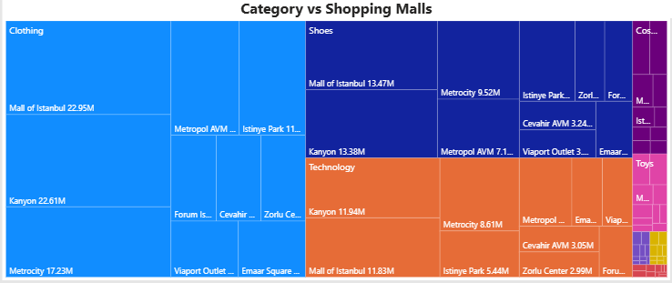
8.Distribution of purchase categories relative to other columns
Clothing leads across all categories, with Cash as the most used payment and top malls driving higher revenue

Slide 25
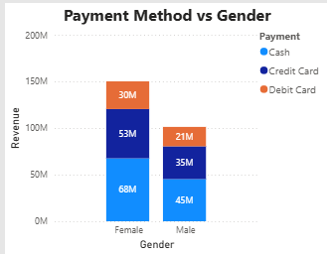
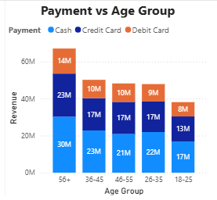
9.Does the payment method have a relation with other columns?
Payment method shows consistent patterns across segments, with Cash preferred across gender, age, shopping malls and categories

Slide 26
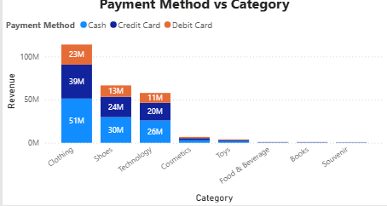
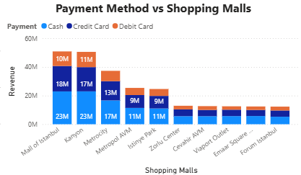
9.Does the payment method have a relation with other columns?

Slide 27
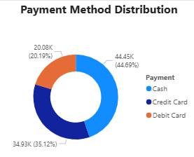
10.How is the distribution of payment methods?
Cash is the most used payment method (~45%), followed by Credit Card and Debit Card

Slide 28
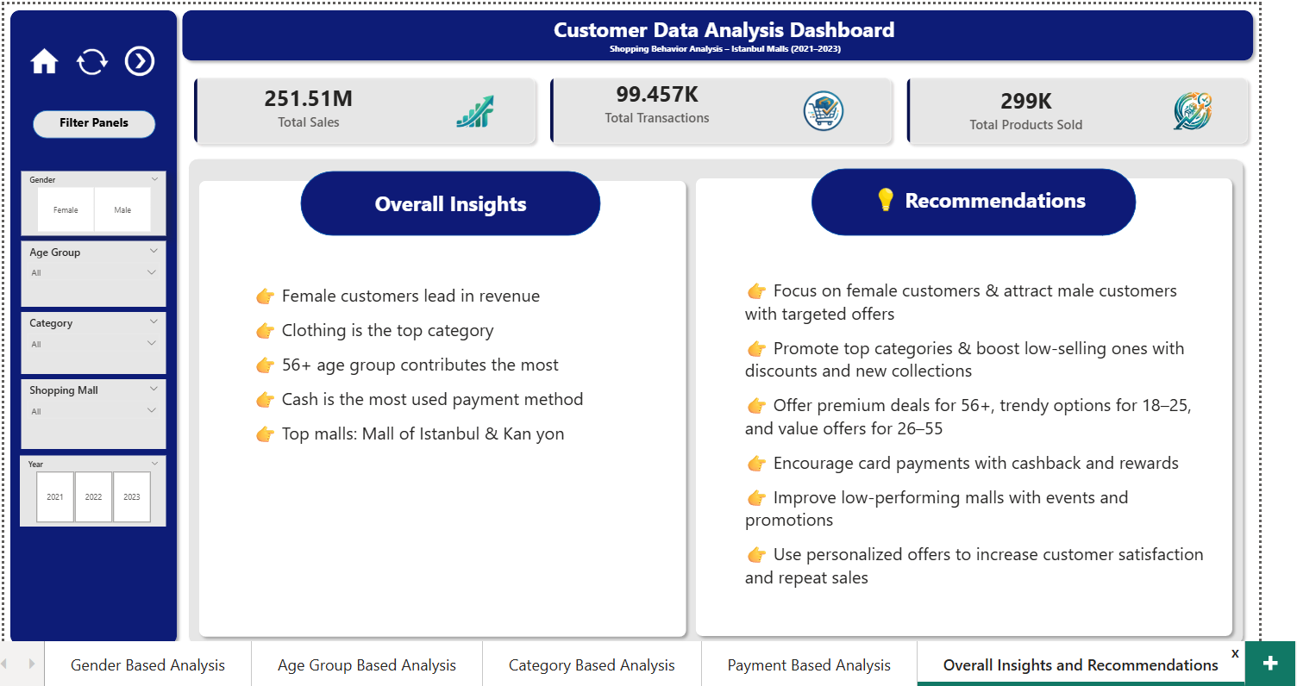
Overall insights and recommendations

Slide 29
Challenges Faced
Age Group Sorting Issue • Age groups stored as text caused incorrect order • Resolved using “Sort by Column”
Dashboard Design • Difficulty in creating a clean and balanced layout
Visualization Selection • Choosing the right charts for clear insights

Slide 30
Key Learnings
Gained hands-on experience in Power BI and data analysis
Learned to: • Clean and prepare datasets • Create calculated measures (Revenue) • Perform customer segmentation (Age Groups) • Build interactive dashboards with KPIs & slicers • Choose effective visualizations
Improved usability using navigation buttons (Home, Reset, Next)

Slide 31
Conclusion
Data-driven insights improve decisions
Dashboard helps easy analysis
Helps in marketing & business growth

Slide 32
THANK YOU

